Slide 1
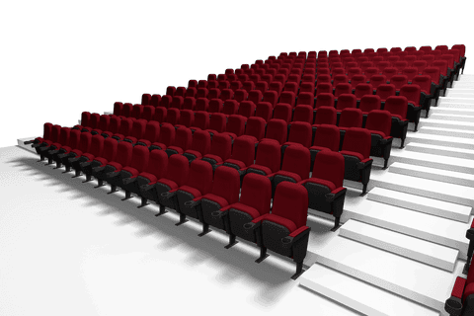
Movie Recommendation System
Earl, Jack, Nick, Ishaq

Slide 2

Introduction
A movie recommendation platform
Uses a large movie dataset (10,000+ films)
Custom recommendation method
Simple GUI using Steamlit

Slide 3
The Purpose
Users can find films by:
Applying their own search filters
Procedurally generated recommendations by “taste”
Understanding a user’s “taste” by allowing them to log/rate movies they have watched

Slide 4
Tree Structure
Genre Tree
Creates connections between styles/genres
Broad at top and particular at the bottom
Child nodes are specific variants of their parent node
Tag Tree
Binary Search Tree
Alphabetically Sorted
For time complexity simplicity

Slide 5
Root
Drama
Action
Comedy
Romance
Crime
Foreign
Mystery
War
Western
Adventure
Thriller
Animation
Documentary
History
Sci-Fi
Fantasy
Music
Horror
TV Movie
Family

Slide 6
Recommendation Logic
A user can apply filters for genres and tags
Uses the Genre Tree to find related genres
Films are assigned “points” towards recommendation based on familial relationships to selected Genre nodes
Understands movies liked by the user through their “watched movie” list

Slide 7
User Database
Users may sign up and sign in
Hashes their passwords using “hashlib”
Saves and continues to authenticate their credentials when they use the platform

Slide 8
Data
Dataset of over 10,000 movies taken from internet
Films are organized by title, genres, director and tags
Data was cleaned and processed, particularly the tags
Very specific tags were replaced with more broad terms so they could interact with other films to be recommended

